Slide 1



Eternal September:
Online Information-Sharing
Community Analysis
Ehsan Gholami, John Karasinski, Jenette Sellin, Dmitry Shemetov
May 26, 2016

Slide 2
Outline
Goals and motivation
Previous works
3 datasets
Reddit
HackerNews
StackExchange
Discussion and conclusions

Slide 3
Research Questions
How does the amount of users’ activity change over time?
How do users’ centrality in the network change over time, both overall and by cohort?
How does comment length change in the community over time, both overall and by cohort?
How do users’ activities change in the community over time, both overall and by cohort?

Slide 4
Research Questions (for today)
How does the amount of users’ activity change over time?
Average number of active users in each cohort
Average number of posts/comments from each cohort
How do users’ centrality in the network change over time, both overall and by cohort?
Average centrality of each cohort over time

Slide 5
Networks change with time
To investigate changes in users’ behavior over time, we divide the users into cohorts (communities).
We then investigate how cohorts behave differently from each other, and how cohorts change over time.

Slide 6
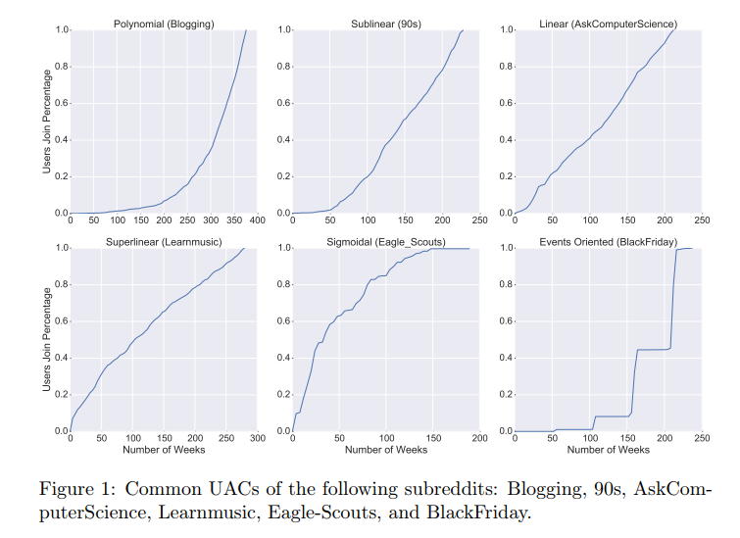
Previous work
Fire, M. et. al “Analyzing Complex Network User Arrival Patterns and Their Effect on Network Topologies”

Slide 7
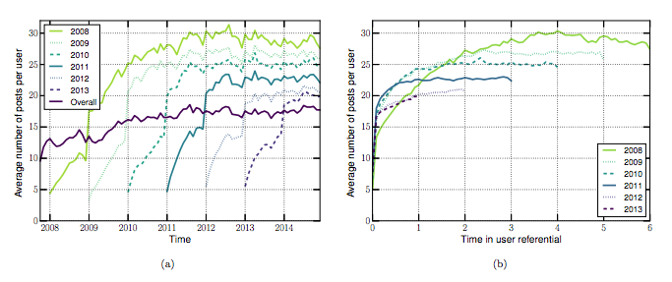
Previous work
Barbosa, S. et. al. “Averaging Gone Wrong: Using Time-Aware Analyses to Better Understand Behavior”

Slide 8
Datasets
 | Reddit (/r/math) | Hacker News | StackExchange (math)
Time | 2008 - 2014 | 2006 - 2016 | 2011 - 2015
Users | 38,832 | 251,715 | 66,702
Comments | 326,355 | 9,082,312 | 1,358,756

Slide 9
Reddit
Reddit is a social website for sharing links, for discussion, and cat photos.
Founded in 2005.

Slide 10

Reddit

Slide 11
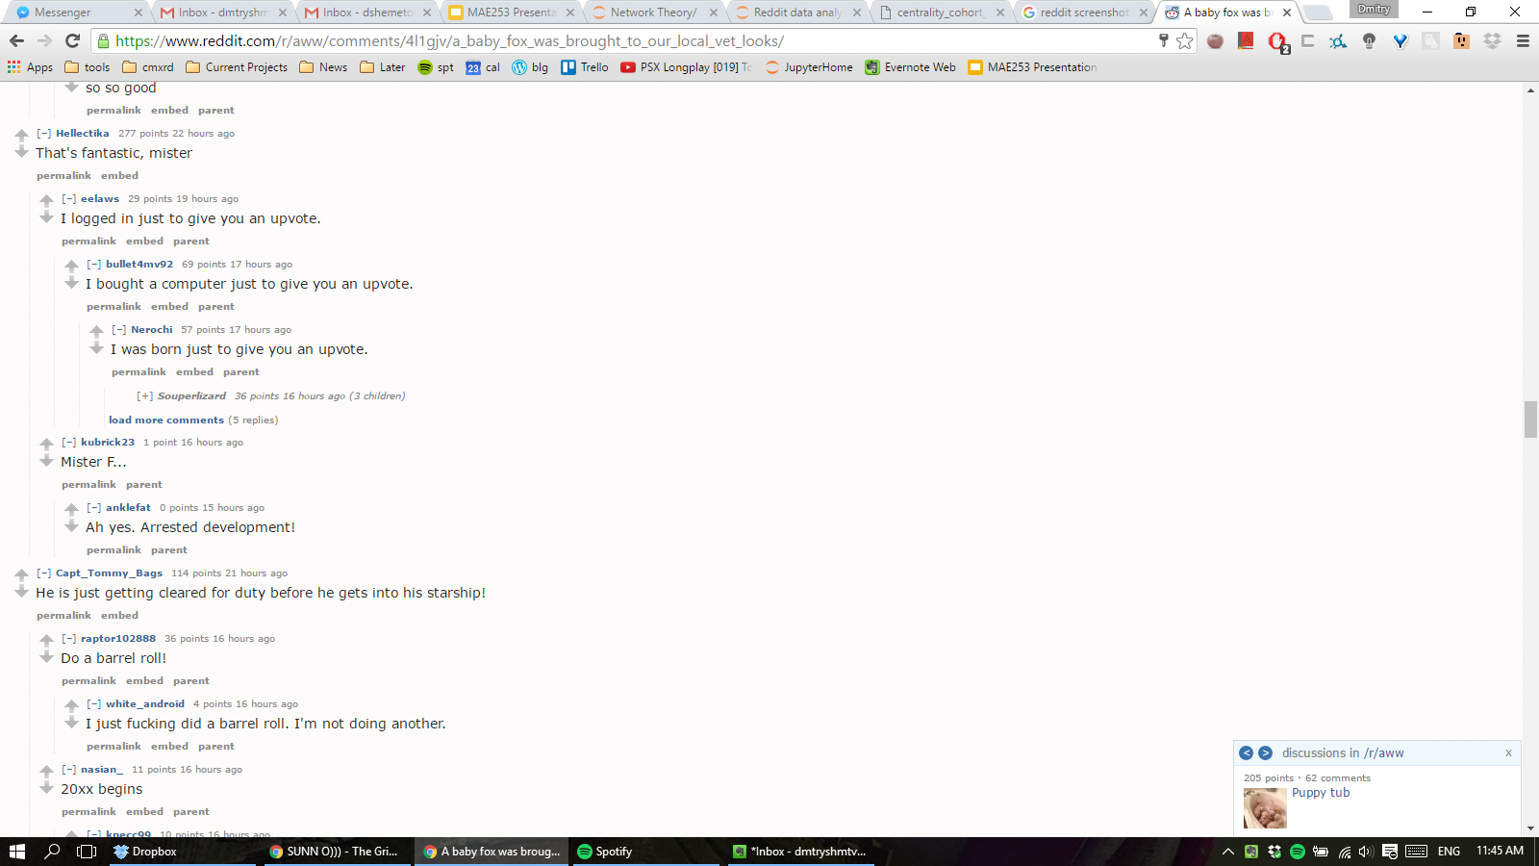
Reddit

Slide 12
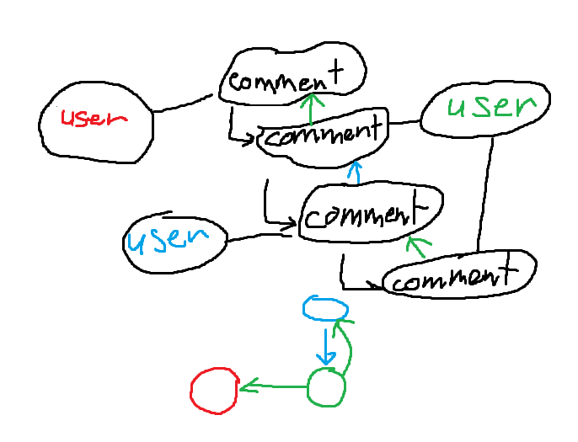
Creating a network out of comments

Slide 13
Analysis
Split the users into cohorts (communities) based on year of first comment. Create a network for every year and check the behavior statistics of each cohort in that year. Behavior statistics:
Comments per user
Closeness centrality

Slide 14
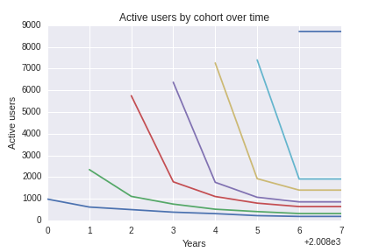
Active users per year
In each cohort, count the number of unique active users per year

Slide 15
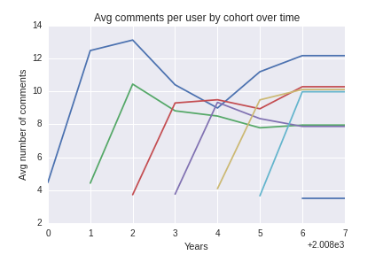
Comments per user over time
Average number of posts per user over time.

Slide 16
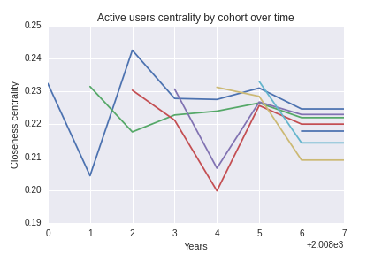
Closeness centrality
Closeness centrality: the reciprocal sum of the shortest distances from every node to a given node.

Slide 17
Hacker News
Hacker News is a social news website focusing on computer science and entrepreneurship. In general, content that can be submitted is defined as
“Anything that good hackers would find interesting. That includes more than hacking and startups. If you had to reduce it to a sentence, the answer might be: anything that gratifies one's intellectual curiosity.”
-Hacker News Guidelines

Slide 18
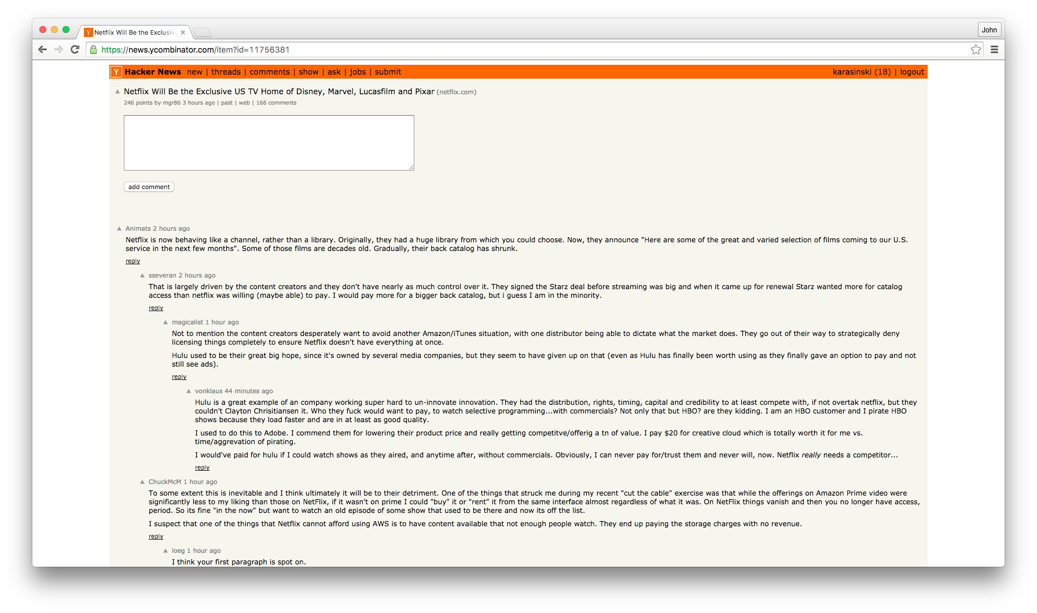

Slide 19
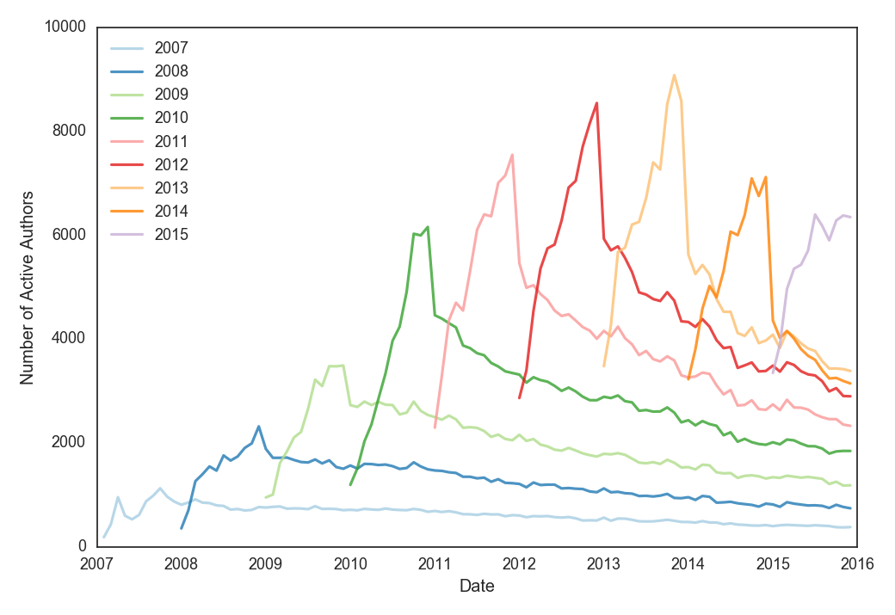
Active users
Active authors by month
An author is active if they posted at least once in a month
Cohorts are defined by the year that an author first commented
Many users that join do not stick around for long.
Number of new users by year appears to have peaked in 2013.

Slide 20
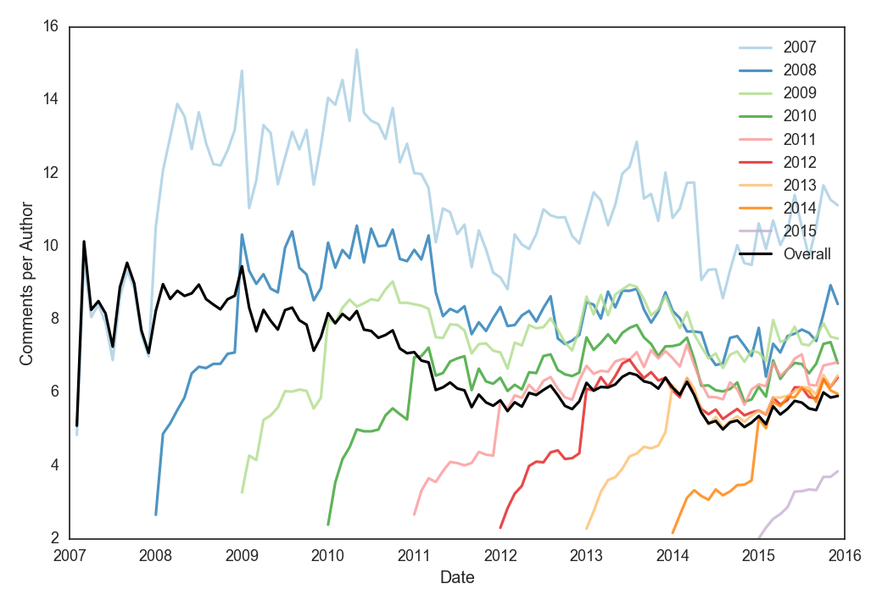
Comments per month per
active user
Overall number of comments per month per user seems to be decreasing slightly over time
Earlier cohorts post more.
Newer cohorts take time to post more often.

Slide 21
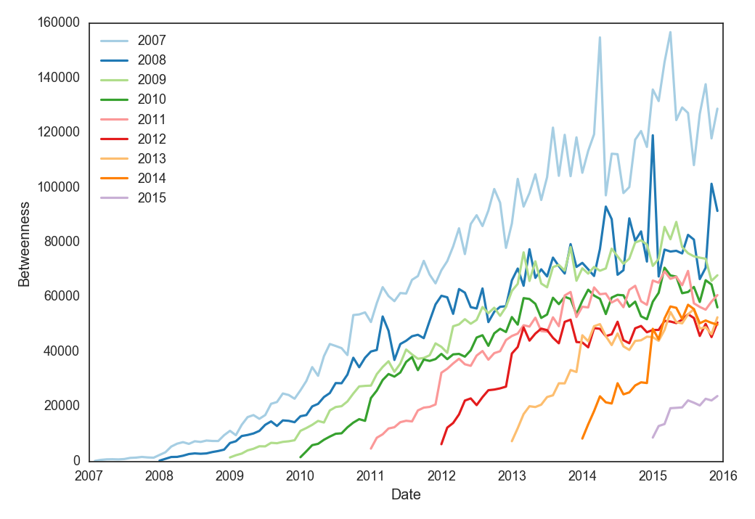
Identifying
Central Users
Calculate the betweenness of the network during each month.
Find the average betweenness for users in each cohort.
Users in older cohorts have a larger number of shortest paths from all vertices to all others that pass through their nodes.

Slide 22
StackExchange
StackExchange is a series of question and answer sites, each relating to a specific topic. In particular, we look at Math StackExchange, which is a forum for anyone studying math to ask and answer questions in mathematics. Users come from all levels of math.
Content ranges from introductory homework problems to open ended theoretical discussion.

Slide 23
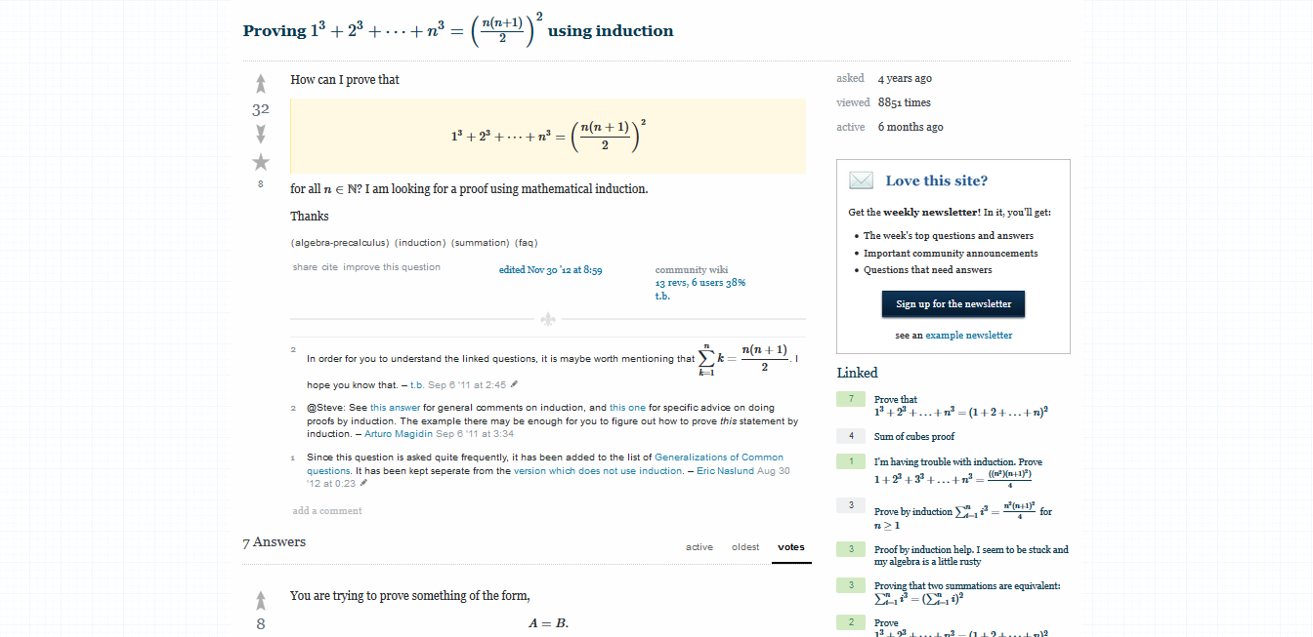

Slide 24
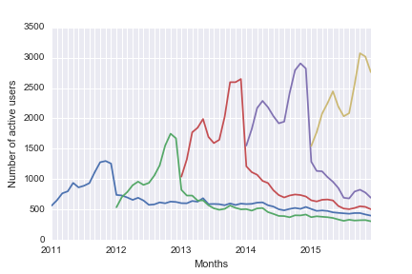
Number of active users per month
Cohorts are determined by the year of a user’s first post (when they joined).
Active users are those who have posted in a given month
Most new users are active for about a year, and then become inactive
Users from all cohorts tend to the same level of activity over time
That level of activity is slowly decreasing

Slide 25
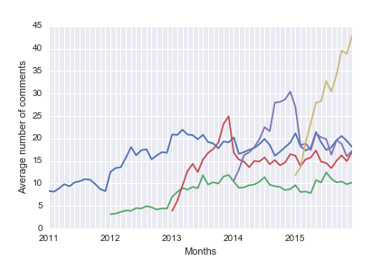
Average number of comments per month
The average number of comments per user has decreased over time, with the exception of the most recent year.
New cohorts have a spike in activity during their first year, and then die back down gradually.
This reflects the fluctuation of active users over their first year.

Slide 26
Conclusions
Old users are more active even though new users outnumber them.
Old users have higher centrality compared to new ones.
Old users are loyal to the system.

Slide 27
Future work
Measure inter-cohort interaction
Detecting community migration from subreddit to subreddit: TrueReddit -> TrueTrueReddit.
It is unclear which metrics can accurately measure the “quality” of the information flowing on a network. Best bet might be to detect community splintering: find points where a piece of the community creates a separate discussion space.

Slide 28
Thank you!
Questions? Suggestions?

Slide 29
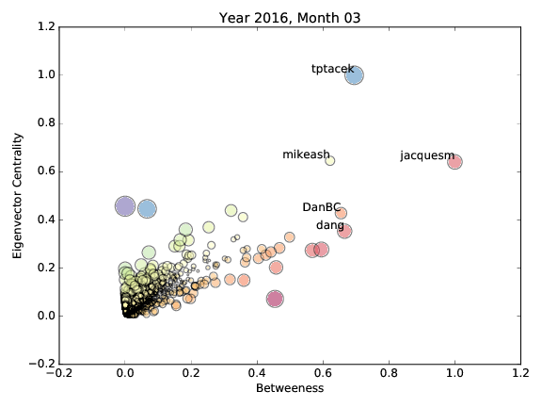
Finding Key Actors
One method to identify key actors is to plot actors’ scores for Eigenvector centrality versus Betweenness. Theoretically, these metrics should be approximately linear; therefore, any non-linear outliers will be of note.
An actor with very high betweenness but low EC may be a critical gatekeeper to a central actor
Likewise, an actor with low betweenness but high EC may have unique access to central actors

